Slide 1
D.R.D.O. SASE’s UAV Fleet Challenge
IIT Tirupati

Slide 2
Introduction
To develop a UAV fleet that can fly autonomously, identify green colored cubes of 15 cm in a 40*40m grid and subsequently communicate the location of the target to the remaining drones and the ground station using swarm technology and finally plot the G.P.S coordinates on a map and display it on a monitor.

Slide 3
Hardware
Flight Controller - Ardupilot (APM 2.8)
APM 2.8 allows the user to turn any fixed, rotary wing or multirotor vehicle into a fully autonomous vehicle; capable of performing programmed GPS missions with waypoints.
Detection, Mapping and communication - Raspberry Pi 3B
Raspberry pi is used as an onboard computer for processing the images and mapping the coordinates.

Slide 4
Software
We have used Mission Planner software for creating waypoints to direct the drone through the predefined path.
The software also provided specific commands to cover a particular area in a grid shaped pattern.
Pandas is an elegant solution for time series data and hence this library has been used for data visualization.
Socket programming is a way of connecting two nodes on a network to communicate with each other

Slide 5
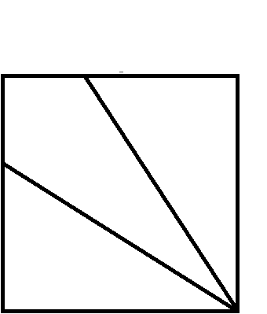
Swarming
1/3
2/3
1/3
2
3
1
2/3
1
1

Slide 6
Detection of Targets
Segmentation of Green Channel
Canny Edge Detector
Dilation
Erosion
Finding number of Contours

Slide 7
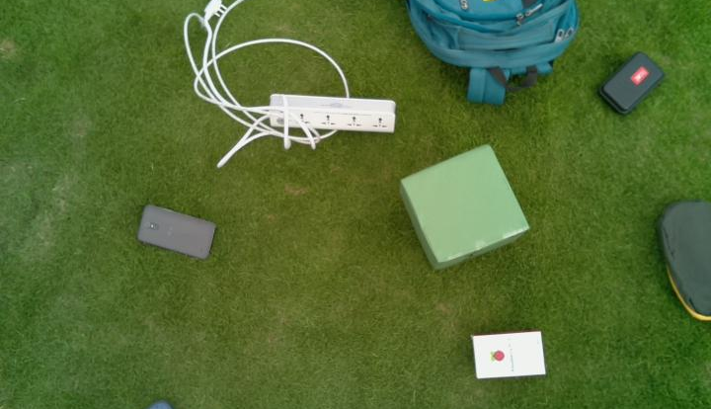
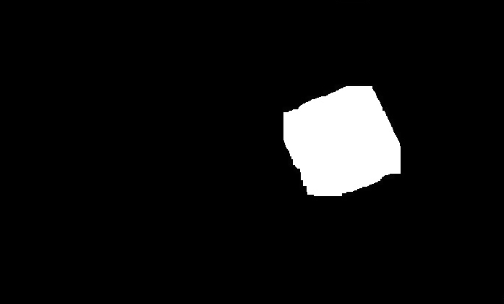
Original Image
Processed Image
If in the processed image, the number of contours is one, then the raspberry pi requests for the gps coordinates from the ardupilot.

Slide 8
Communication
Ardupilot
Ardupilot
Ardupilot
Raspberry pi
Raspberry pi
Raspberry pi
Ground station

Slide 9
Planning and Cost
We have firstly tested and carried out the image processing with a single UAV and there on we proceeded with the other two UAV’s and have successfully managed to implement image processing and inter drone communication using socket programming.
Cost (per UAV) :
5200 Lipo Battery - 4000 INR
Drone Kit - 2300 INR
Ardupilot 2.8 - 2500 INR
Raspberry pi 3 - 2700 INR
GPS module - 1800 INR
Overall Cost - 13300 INR

Slide 10
Conclusion
We were able to automate drone’s flight path by creating the way points such that they are bounded by a grid.
In various successive trials we were able to implement the technique of image processing and plot the gps coordinates on a map but were not able to achieve swarming of UAV’s .

